Slide 1
Object Oriented Programming CS F213
Dr. Pranav M Pawar

Slide 2
Contents
Design Patterns: Introduction
Example: Iterator Pattern
Classification of Design Patterns
Creational patterns
Structural patterns
Behavioural patterns
Sources (Slide 3 to 10):
https://www.javatpoint.com/observer-pattern
Cay Horstmann, Object Oriented Design & Patterns, John Wiley & Sons, 2006, 2nd Edition

Slide 3
Design Patterns: Introduction
Designing OO Software is hard
To find relevant objects
Factor them into classes
Define class Interfaces
Define inheritance hierarchies
Establish key relationships among them
OO Design must be
Specific to the problem at hand
General to address future problems and requirements
Design Patterns: Descriptions of communicating objects and classes that are customized to solve a general design problem in a particular context.

Slide 4
Design Patterns: Introduction
Why Design Patterns?
They make it easier to reuse successful designs
Expressing proven techniques makes them more accessable
They help you choose design alternatives
They can improve the documentation and maintenance
They help to get a design “right” faster
In general a pattern has
Pattern Name: In short
Problem
When to apply the pattern.
Solution
Describes the elements that make up the design, their relationships, responsibilities, and collaborations.
Context
Describes a recurring set of situations in which the pattern can be applied.
Example class diagram for application

Slide 5
Example: Iterator Pattern
Name: ITERATOR pattern
Teaches how to access the elements of an aggregate object (ArrayList, LinkedList).
Problem
How to access elements of an aggregate objects.
Context
An object (which we’ll call the aggregate) contains other objects (which we’ll call elements).
Clients (that is, methods that use the aggregate) need access to the elements.
The aggregate should not expose its internal structure.
There may be multiple clients that need simultaneous access.
Solution
Define an iterator that fetches one element at a time.
Each iterator object needs to keep track of the position of the next element to fetch.
If there are several variations of the aggregate and iterator classes, it is best if they implement common interface type. Then the client only needs to know the interface types, not the concrete classes.

Slide 6
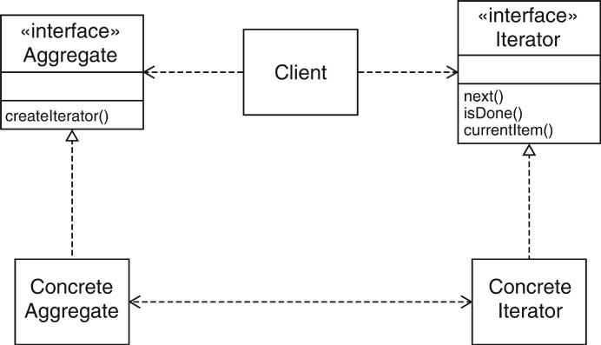
Example: Iterator Pattern
Name in Design Pattern | Actual Name
Aggregate | List
ConcreteAggregate | LinkedList
Iterator | ListIterator
ConcreteIternator | An anonymous class that implements the ListIterator interface type
createIterator() | listIterator()
next() | next()
isDone() | Opposite of hasNext()
currentItem() | Return value of next()

Slide 7
OBSERVER Pattern
Model/view/controller architecture
Model
The raw data
Data structure
No visual appearance
Views
Visual representations
Controllers
An object that processes user interaction (using mouse, keyboard, GUI interface, …)
Each view has a controller.

Slide 8
OBSERVER Pattern
When a user types text into one of the windows:
The controller tells the models to insert the text that the user typed.
The model notifies all views of a change in the model.
All views repaint themselves.
During paint, each view asks the models for the current text.
This architecture minimizes the coupling between the model, views, and controllers.

Slide 9
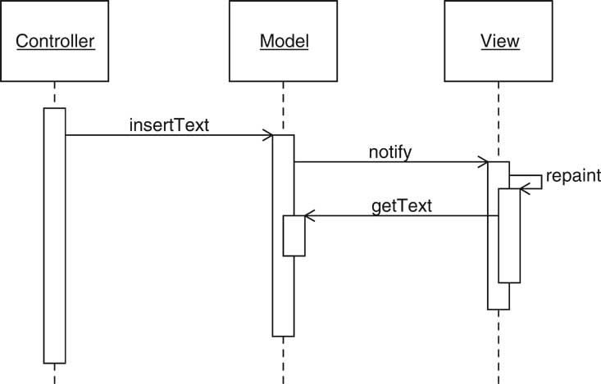
OBSERVER Pattern

Slide 10
OBSERVER Pattern
The OBSERVER pattern teaches how an object can tell other objects about events.
Context
An object (which we’ll call the subject) is source of events (such as “my data has changed”).
One or more objects (called the observer ) want to know when an event occurs.

Slide 11
OBSERVER Pattern
Solution
Define an observer interface type. Observer classes must implement this interface type.
The subject maintains a collection of observer objects.
The subject class supplies methods for attaching observers.
Whenever an event occurs, the subject notifies all observers.

Slide 12
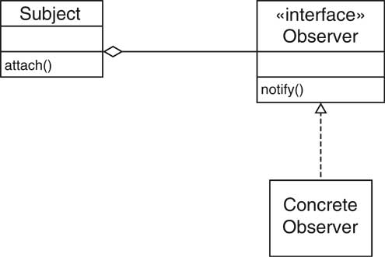
OBSERVER Pattern

Slide 13
OBSERVER Pattern
Name in Design Pattern | Actual Name
Subject | JButton
Observer | ActionListener
ConcreteObserver | The class that implements the ActionListener interface type
attach() | addActionListener
notify() | actionPerformed

Slide 14
COMPOSITE Pattern Containers and Components
Containers collect GUI components
Sometimes, want to add a container to another container
Container should be a component
Composite design pattern
Composite method typically invoke component methods
E.g. Container.getPreferredSize invokes getPreferredSize of components

Slide 15
COMPOSITE Pattern Containers and Components
The COMPOSITE pattern teaches how to combine several objects into an object that has the same behavior as its parts.

Slide 16
COMPOSITE Pattern
Context
Primitive objects can be combined to composite objects
Clients treat a composite object as a primitive object
Solution
Define an interface type that is an abstraction for the primitive objects
Composite object contains a collection of primitive objects
Both primitive classes and composite classes implement that interface type.
When implementing a method from the interface type, the composite class applies the method to its primitive objects and combines the results.

Slide 17
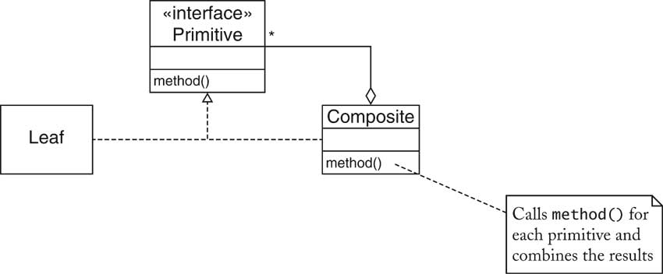
COMPOSITE Pattern

Slide 18
COMPOSITE Pattern
Name in Design Pattern | Actual Name
Primitive | Component
Composite | Container or a subclass such as JPanel
Leaf | A component that has no children such as JButton or JTextArea
method() | A method of the Component interface such as getPreferredSize

Slide 19
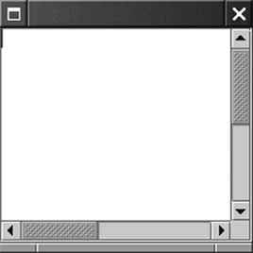
DECORATOR Pattern Scroll Bars
Scroll bars can surround component
JTextArea area = new JTextArea(10, 25);
JScrollPane pane = new JScrollPane(area);
JScrollPane is again a component

Slide 20
DECORATOR Pattern Scroll Bars
The DECORATOR pattern teaches how to form a class that adds functionality to another class while keeping its interface.

Slide 21
DECORATOR Pattern
Context
Component objects can be decorated (visually or behaviorally enhanced)
The decorated object can be used in the same way as the undecorated object
The component class does not want to take on the responsibility of the decoration
There may be an open-ended set of possible decorations

Slide 22
DECORATOR Pattern
Solution
Define an interface type that is an abstraction for the component
Concrete component classes implement this interface type.
Decorator classes also implement this interface type.
A decorator object manages the component object that it decorates
When implementing a method from the component interface type, the decorator class applies the method to the decorated component and combines the result with the effect of the decoration.

Slide 23
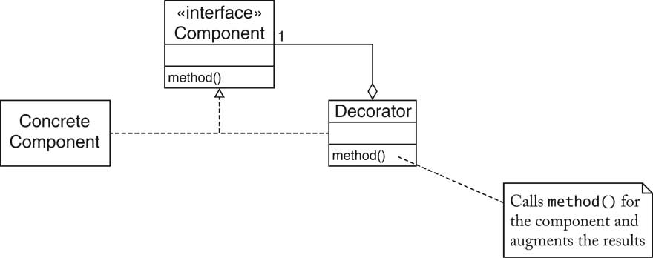
DECORATOR Pattern

Slide 24
DECORATOR Pattern
Name in Design Pattern | Actual Name
Component | Component
ConcreteComponent | JTextArea
Decorator | JScrollPane
method() | A method of the Component interface. For example, the paint method paints a part of the decorated component and the scroll bars.

Slide 25
Classification of Design Patterns
Design patterns were originally classified into three types
Creational patterns
Creational design patterns are design patterns that deal with object creation mechanisms, trying to create objects in a manner suitable to the situation.
Structural patterns
Are design patterns that ease the design by identifying a simple way to realise relationships between entities.
These describe how objects and classes combine themselves to form a large structure
Behavioural patterns
Design patterns that identify common communication patterns between objects and realize these patterns.
These patterns increase flexibility in carrying out this communication.

Slide 26
Creational patterns
A Factory Pattern or Factory Method Pattern says that just define an interface or abstract class for creating an object but let the subclasses decide which class to instantiate. In other words, subclasses are responsible to create the instance of the class.
Abstract Factory Pattern says that just define an interface or abstract class for creating families of related (or dependent) objects but without specifying their concrete sub-classes. That means Abstract Factory lets a class returns a factory of classes.
Singleton Pattern says that just define a class that has only one instance and provides a global point of access to it". In other words, a class must ensure that only single instance should be created and single object can be used by all other classes.
Prototype Pattern says that cloning of an existing object instead of creating new one and can also be customized as per the requirement. This pattern should be followed, if the cost of creating a new object is expensive and resource intensive.

Slide 27
Structural patterns
An Adapter Pattern says that just "converts the interface of a class into another interface that a client wants". In other words, to provide the interface according to client requirement while using the services of a class with a different interface.
A Composite Pattern says that just "allow clients to operate in generic manner on objects that may or may not represent a hierarchy of objects".
A Decorator Pattern says that just "attach a flexible additional responsibilities to an object dynamically". In other words, The Decorator Pattern uses composition instead of inheritance to extend the functionality of an object at runtime.
Proxy means an object representing another object. A Proxy Pattern "provides the control for accessing the original object".

Slide 28
Behavioural patterns
A Command Pattern says that "encapsulate a request under an object as a command and pass it to invoker object. Invoker object looks for the appropriate object which can handle this command and pass the command to the corresponding object and that object executes the command”.
A Strategy Pattern says that "defines a family of functionality, encapsulate each one, and make them interchangeable". The Strategy Pattern is also known as Policy.
Iterator Pattern is used "to access the elements of an aggregate object sequentially without exposing its underlying implementation". The Iterator pattern is also known as Cursor.
An Observer Pattern says that "just define a one-to-one dependency so that when one object changes state, all its dependents are notified and updated automatically". The Memento pattern is also known as Dependents or Publish-Subscribe.

Slide 29
Thank you.

